Slide 1


Maintaining the Brain Functional Connectivity (BFC)
in the gambling task using the HCP fMRI data-set.
Colorful Snowshoes Pod – July 2021
Mentors:
Caroline Nettekoven
Teaching assistant:
Kirsten Petras
Mehrnaz Hosseinizadeh
Project members:
Moustafa Shomer, [shomerthesec@gmail.com]
Sai Ganesh, [nsaiganesh2003@gmail.com]
Hussein Nasser Al Islami, [h.nasereslami@yahoo.com]
Maintaining the Brain Functional Connectivity (BFC) in the gambling task using the HCP fMRI data-set.
Colorful Snowshoes Pod – July 2021
0

Slide 2
Our Question:
Are there any regions and networks which are more affected by the Win and Loss Event conditions corresponding to someone’s decision?
Maintaining the Brain Functional Connectivity (BFC) in the gambling task using the HCP fMRI data-set.
Colorful Snowshoes Pod – July 2021
1

Slide 3
Introduction:
To analyze data-set being preprocessed by HCP© for NMA-2021 that they recorded using fMRI is to analyze in this project to maintain connectivity and correlation of the areas which are involved in the task. What we did was make it inquiry what rate of connectivity and correlation are involved during the gambling task designed to evaluate reaction of participants to stimulus.
The test info:
339 subjects, aged 22-35
360 Parcellated cortical regions, 180/hemisphere
Maintaining the Brain Functional Connectivity (BFC) in the gambling task using the HCP fMRI data-set.
Colorful Snowshoes Pod – July 2021
2

Slide 4
Project Plan:
We use fMRI data of 339 subjects from Human Connectome Project’s gambling task.
A contrast of the brain's Parcells average activity in reward and loss conditions will be computed for each subject
we will do a parcel based GLM to identify the most sensitive areas of the brain to lose/win distinction.
Then we will make a correlation matrix of task-dependent functional connectivity of the whole brain to those ROIs we found and compare it for loss and win conditions.
Maintaining the Brain Functional Connectivity (BFC) in the gambling task using the HCP fMRI data-set.
Colorful Snowshoes Pod – July 2021
3

Slide 5
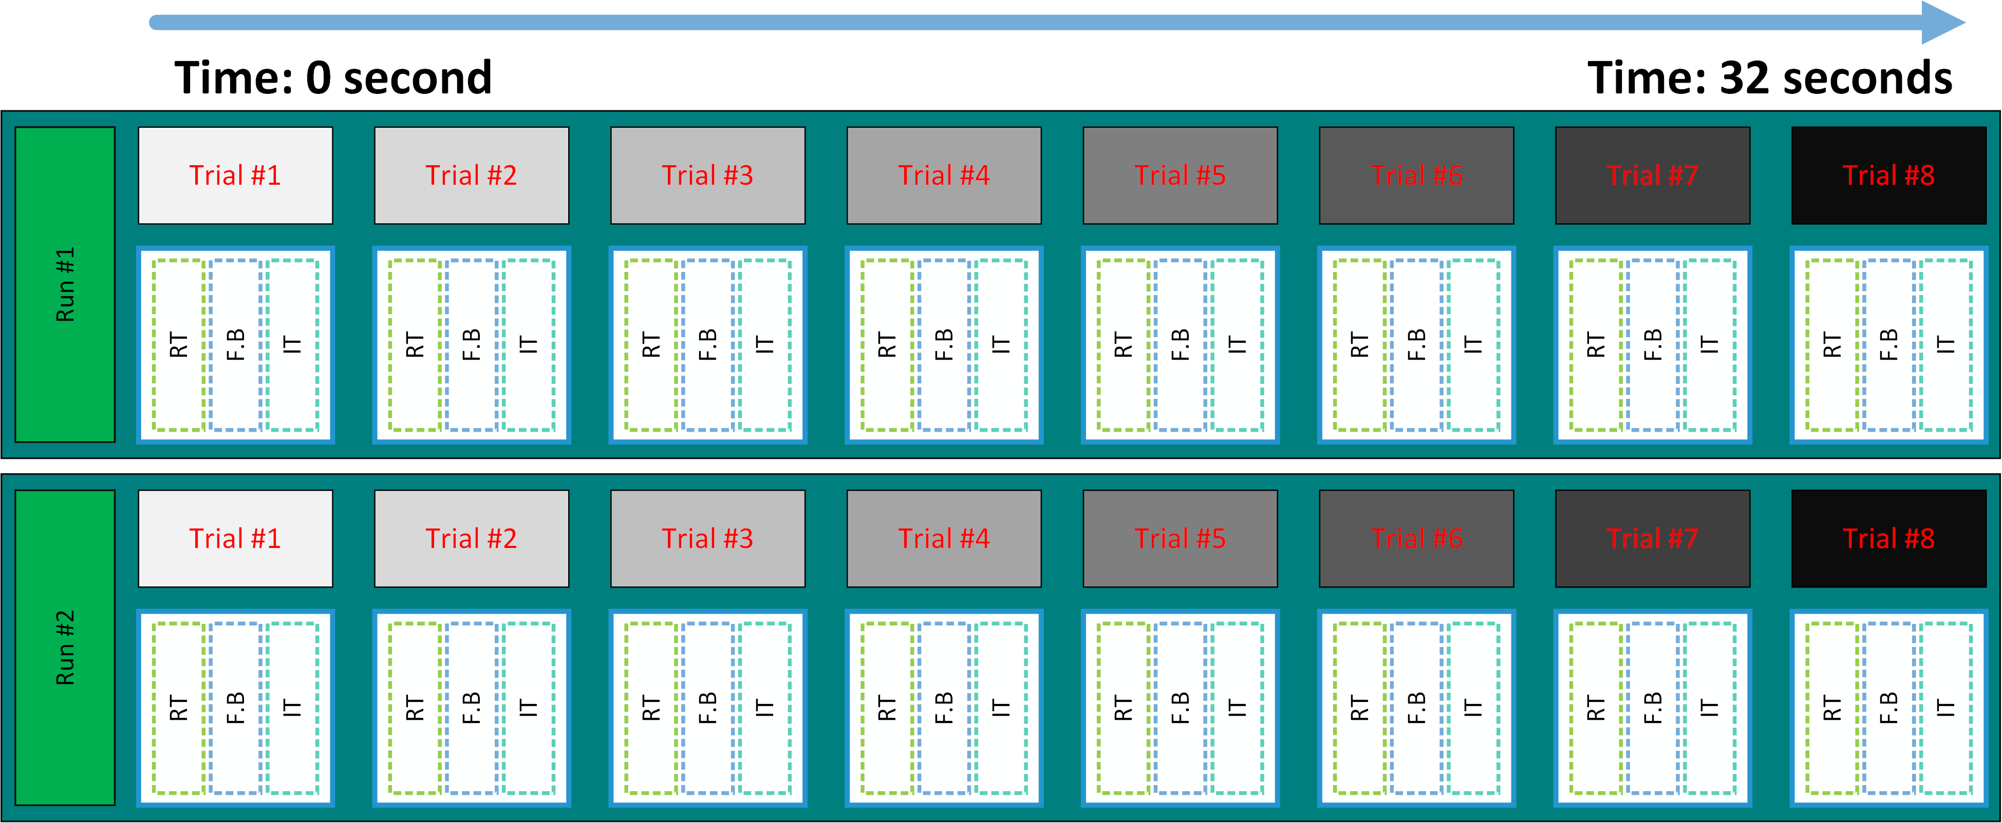
Methodology:
?
7
Condition #1 ~ 1$ reward
?
3
Condition #2 ~ 0.5 c punishment
?
5
Condition #3 ~ neutral
Maintaining the Brain Functional Connectivity (BFC) in the gambling task using the HCP fMRI data-set.
Colorful Snowshoes Pod – July 2021
4

Slide 6
Step by step into the gambling:
HCP
Average
GLM
ROIs
NaN
Test taking
Data sorting
Analyzing
Maintaining the Brain Functional Connectivity (BFC) in the gambling task using the HCP fMRI data-set.
Colorful Snowshoes Pod – July 2021
5

Slide 7
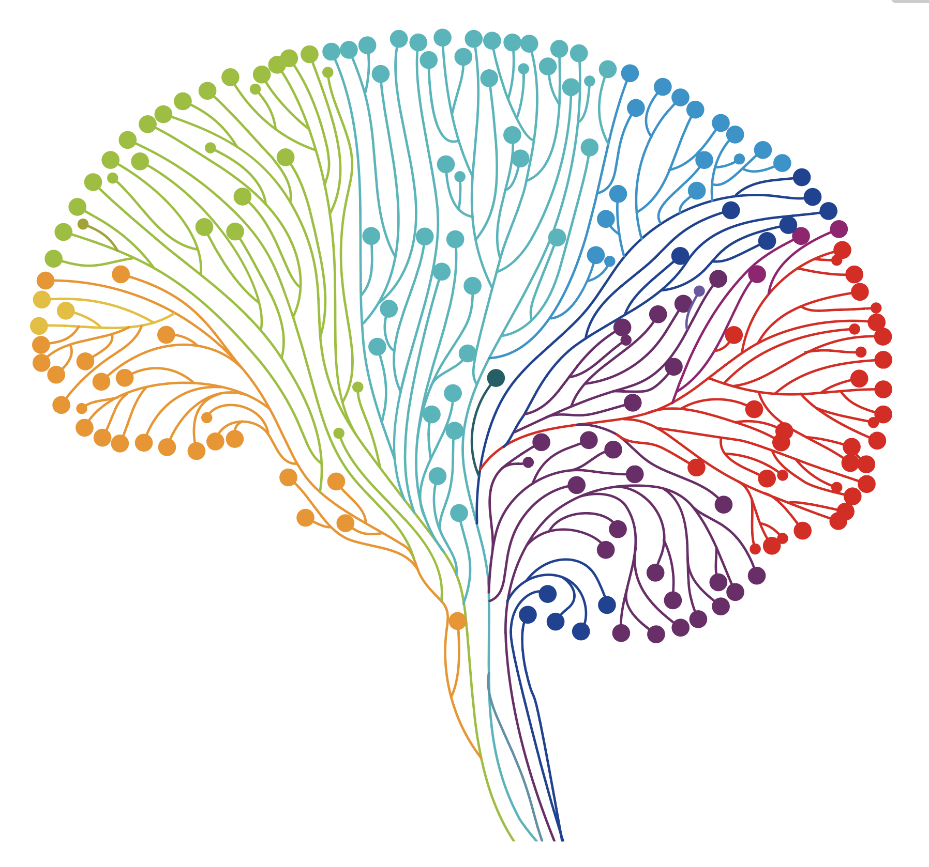
Data Wrangling
Our data: explanatory variables / condition time / regions.
Our approach:
Creating a data frame for the brain activity. for each subject and run
Averaging the activity over the condition time. for each parcel
Choosing the highest informative parcels. rate of activity in fMRI
Using GLM models. to ensure that our findings are accurate
Building the correlation matrix for win/loss conditions among all interested parcels.
Visualizing the brain connectivity based on the correlations.
Maintaining the Brain Functional Connectivity (BFC) in the gambling task using the HCP fMRI data-set.
Colorful Snowshoes Pod – July 2021
6

Slide 8
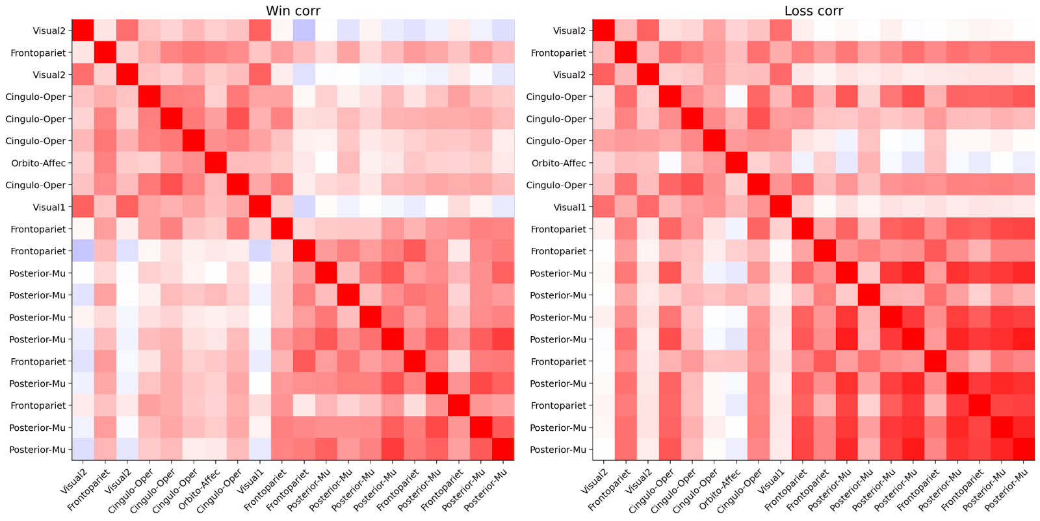
Correlation Matrix
Maintaining the Brain Functional Connectivity (BFC) in the gambling task using the HCP fMRI data-set.
Colorful Snowshoes Pod – July 2021
7

Slide 9
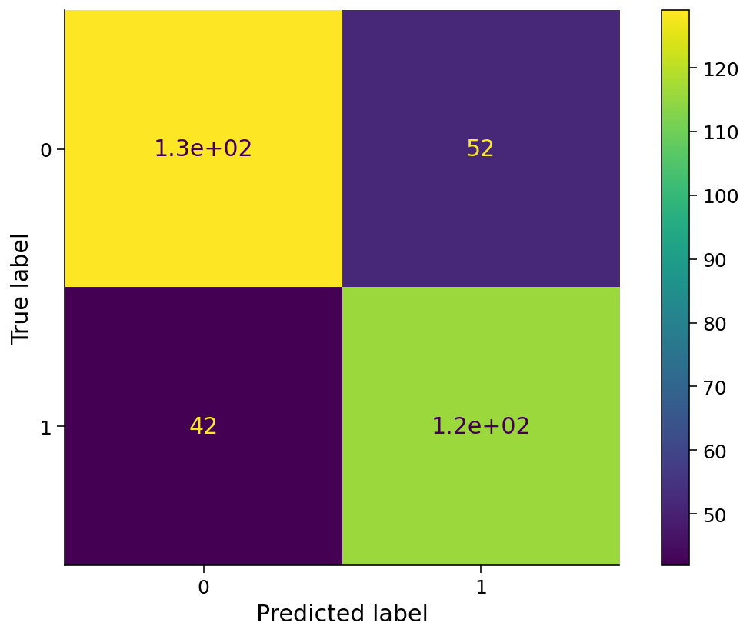
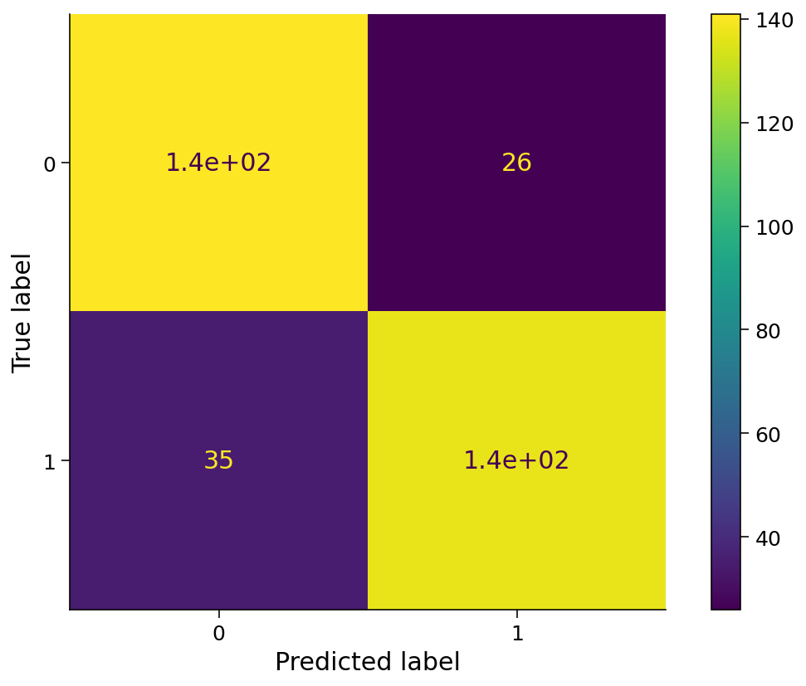
True / Predication
The 20 parcels give the accuracy of result in amount of 0.76, which is analyzed with Ridge Classifier with 20 cross-validation
While using the whole 360 parcels with a Logistic Regression model and 20 cross-validation, gave us 0.82 accuracy.
which is higher than our chosen 20 parcels by 6% only.
20 parcels modeling Vs 360 parcels modeling
Maintaining the Brain Functional Connectivity (BFC) in the gambling task using the HCP fMRI data-set.
Colorful Snowshoes Pod – July 2021
8

Slide 10
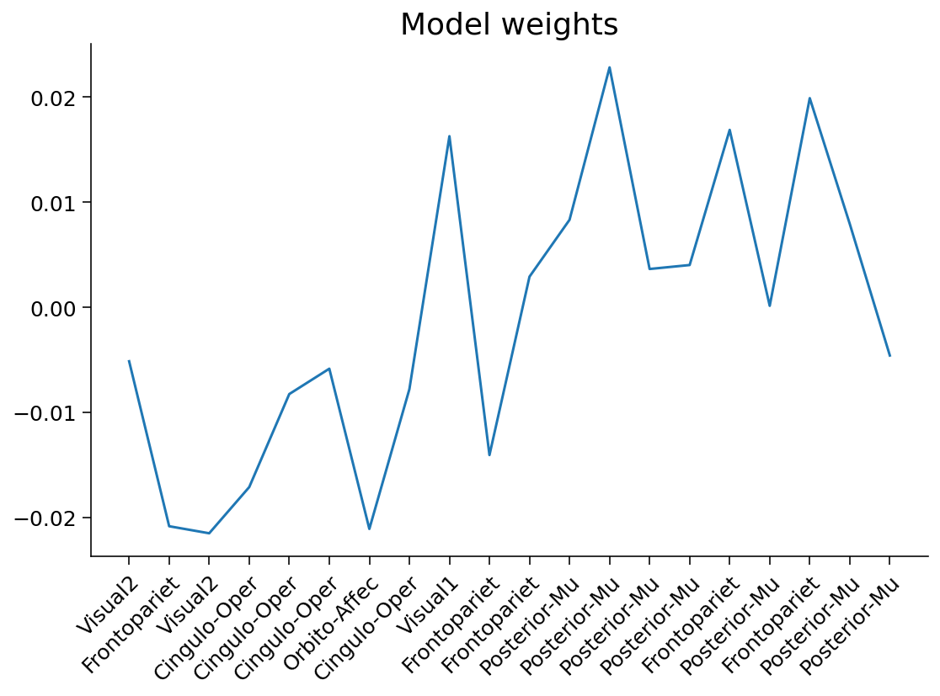
Model weights for the 20 parcels
Maintaining the Brain Functional Connectivity (BFC) in the gambling task using the HCP fMRI data-set.
Colorful Snowshoes Pod – July 2021
9

Slide 11
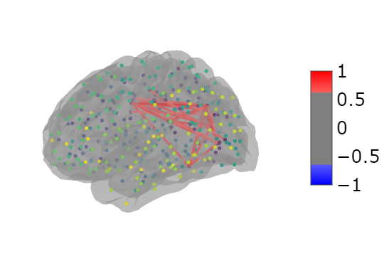
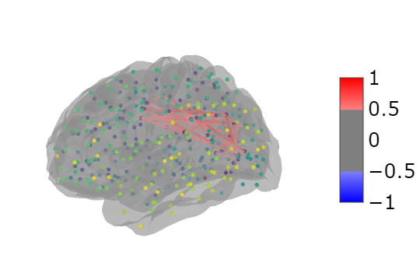
In the brain
Brain connectivity for Loss & Win
Maintaining the Brain Functional Connectivity (BFC) in the gambling task using the HCP fMRI data-set.
Colorful Snowshoes Pod – July 2021
10

Slide 12
The universe let us be a human being.
what we do is try to be a good human.
#save_water_resources
#save_Hawizeh_Marshes
#save_ Khuzestan
Maintaining the Brain Functional Connectivity (BFC) in the gambling task using the HCP fMRI data-set.

